Slide 1
Data Science
CSE-4077
(Linear Algebra)

Slide 2
Is there anything more useless or less useful than Algebra?
Billy Connolly
Linear Algebra has become as basic and as applicable
as calculus, and fortunately it is easier.
Gilbert Strang, MIT

Slide 3
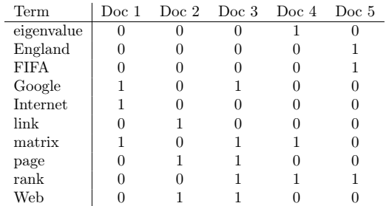
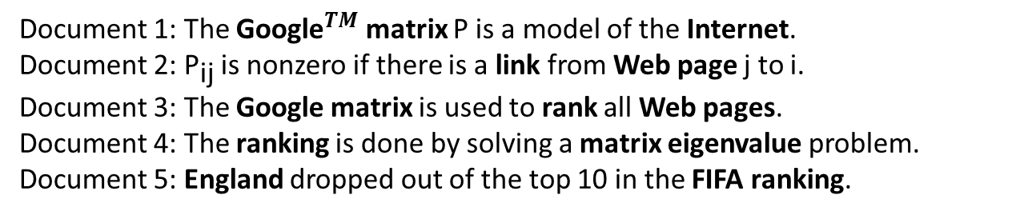
Term-document matrices are used in information retrieval. Consider the following selection of five documents. Key words, which we call terms, are marked in boldface.
Document 1: The ${\text{Google}}^{TM}$ matrix P is a model of the Internet.
Document 2: ${\text{P}}_{\text{ij}}$ is nonzero if there is a link from Web page j to i.
Document 3: The Google matrix is used to rank all Web pages.
Document 4: The ranking is done by solving a matrix eigenvalue problem. Document 5: England dropped out of the top 10 in the FIFA ranking.

Slide 4
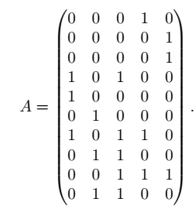
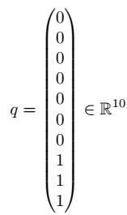
Thus each document is represented by a vector, or a point, in ${\text{R}}^{\text{10}}$, and we can organize all documents into a term-document matrix:
Now assume that we want to find all documents that are relevant to the query “ranking of Web pages.” This is represented by a query vector, constructed in a way analogous to the term-document matrix:

Slide 5
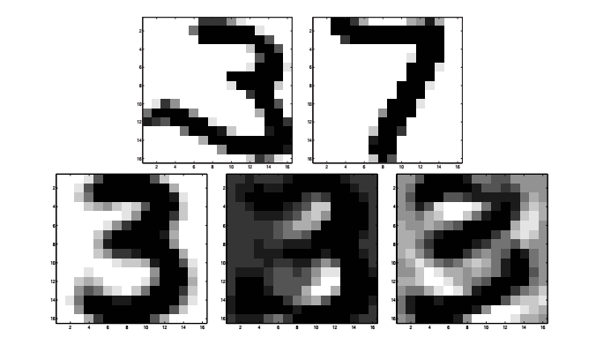
Another application

Slide 6

Linear Algebra
Linear algebra is the branch of mathematics concerning linear equations such as
linear functions such as
and their representations through matrices and vector spaces.

Slide 7
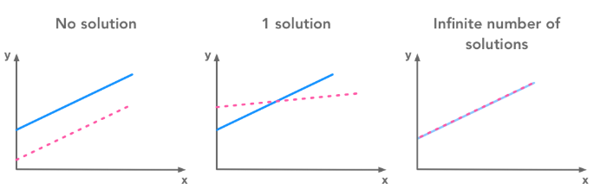
Linear Algebra

Slide 8
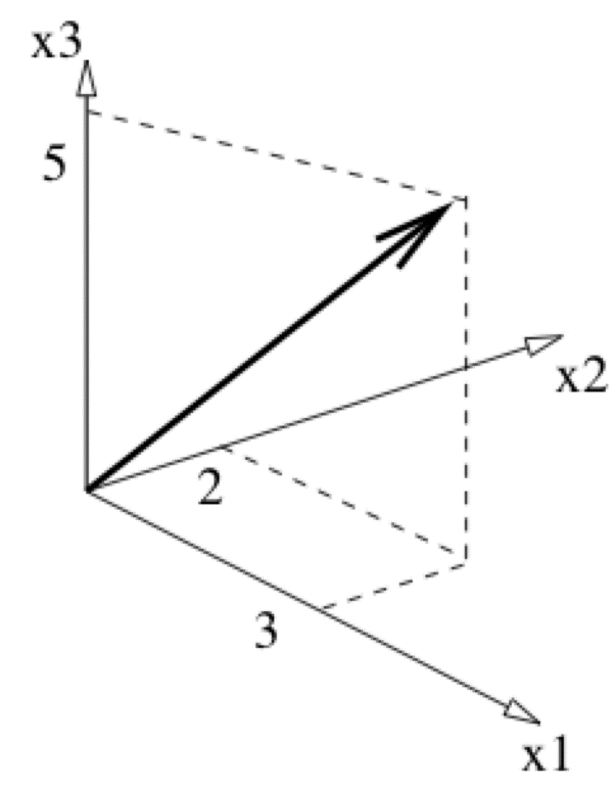
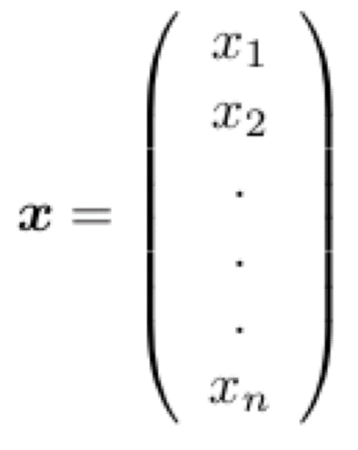
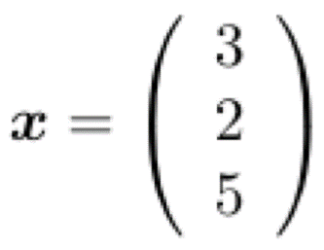
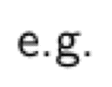
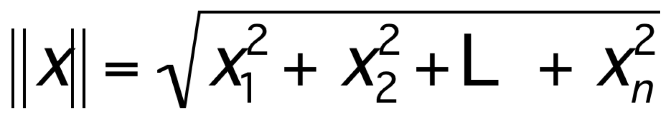
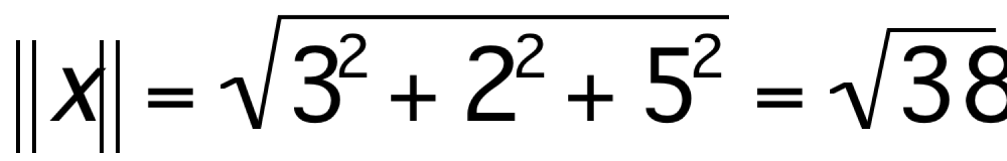
Vectors
The length of x, a.k.a. the norm or 2-norm of x, is
e.g.,

Slide 9
Vector Addition: A+B
A+B
A
A+B = C
(use the head-to-tail method to combine vectors)
B
C
B
A

Slide 10
Scalar Product
av
v
Change only the length (“scaling”), but keep direction fixed.
Sneak peek: matrix operation (Av) can change length,
direction and also dimensionality!

Slide 11
Vectors: Dot Product
Think of the dot product as a matrix multiplication
The magnitude is the dot product of a vector with itself
The dot product is also related to the angle between the two vectors

Slide 12
Vectors: Cross Product
The cross product of vectors A and B is a vector C which is perpendicular to A and B
The magnitude of C is proportional to the sin of the angle between A and B
The direction of C follows the right hand rule if we are working in a right-handed coordinate system
A×B
B
A

Slide 13
What is a Matrix?
A matrix is a set of elements, organized into rows and columns
rows
Rectangular (3 x 2)
columns
Square (3 x 3)
Matrix locations/size defined as rows x columns (R x C)

Slide 14
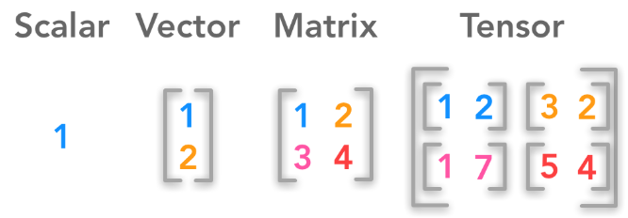
Scalars, Vectors, Matrices and Tensors
A scalar is a single number
A vector is an array of numbers.
A matrix is a 2-D array
A tensor is a n-dimensional array with n>2

Slide 15
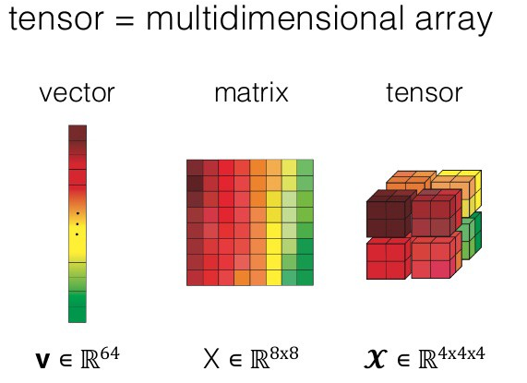
Tensor

Slide 16
Basic Matrix Operations
Addition, Subtraction, Multiplication: creating new matrices (or functions)
Just add elements
Just subtract elements
Multiply each row by each column

Slide 17
Matrix Times Matrix

Slide 18
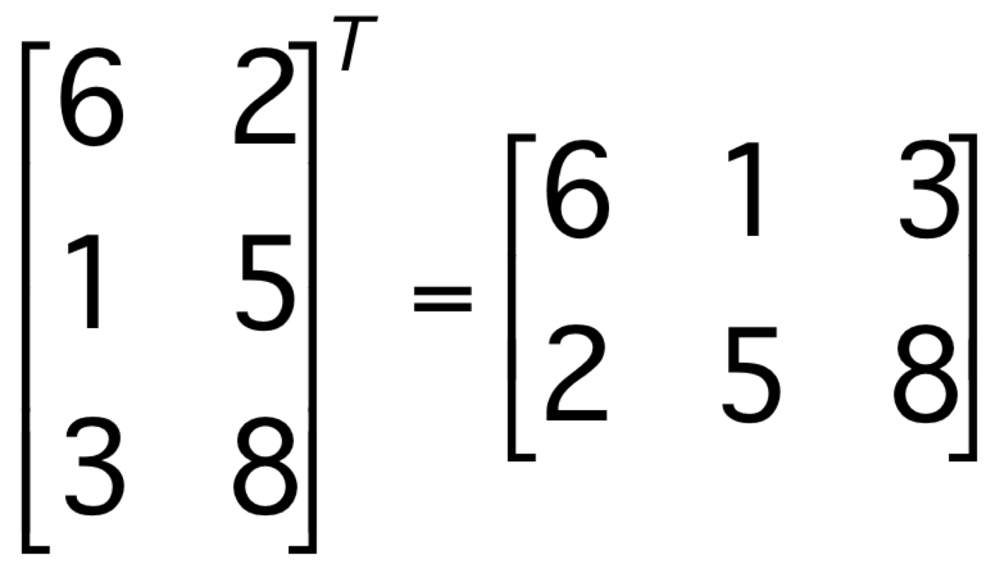
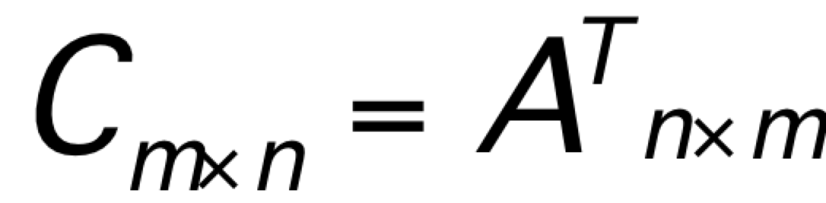
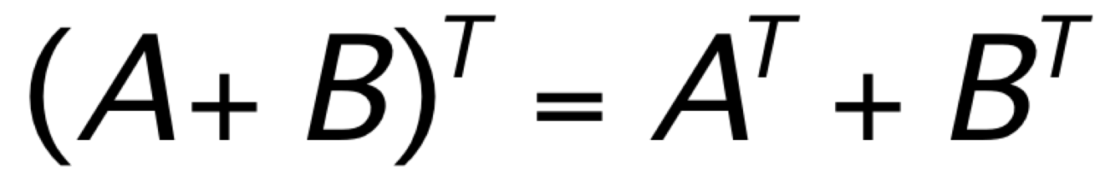
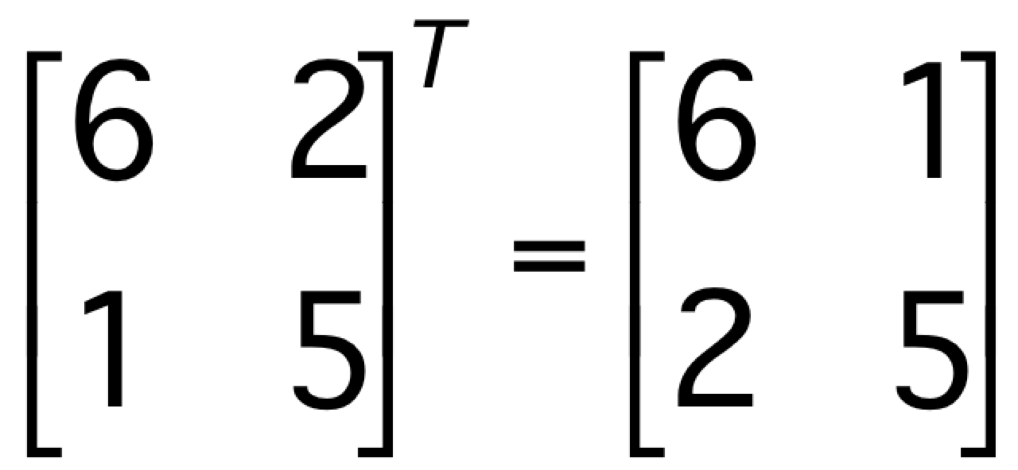
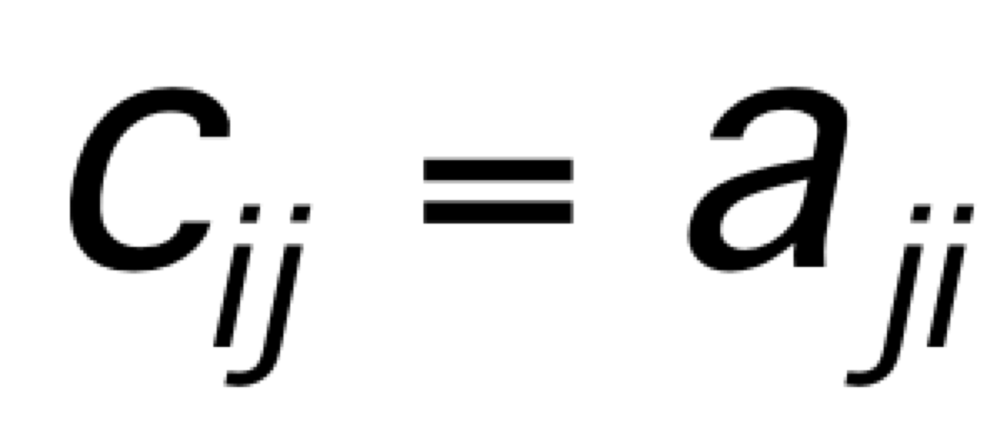
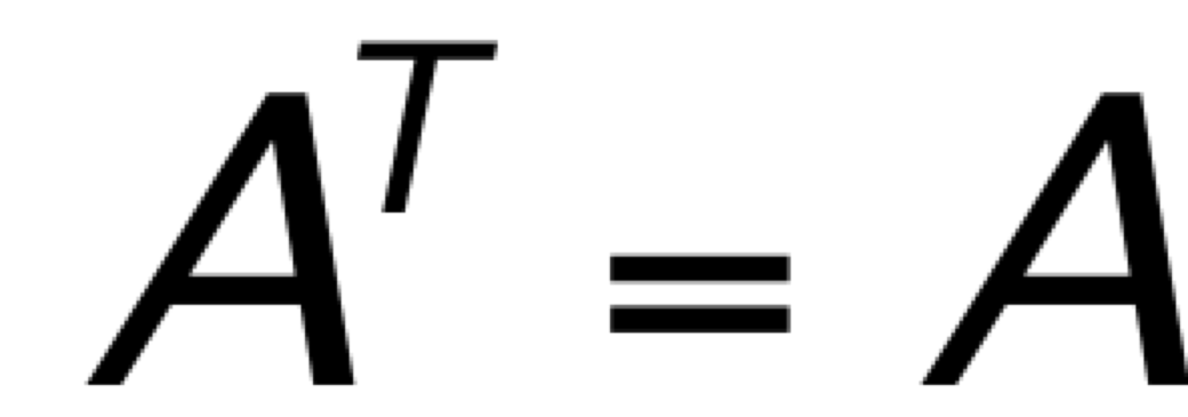
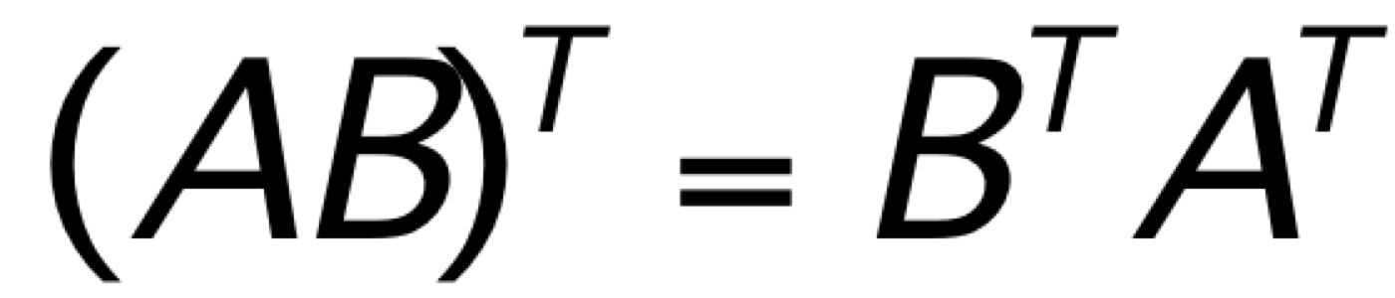
Transpose of a Matrix
Transpose:
Examples:
If
, we say A is symmetric.

Slide 19
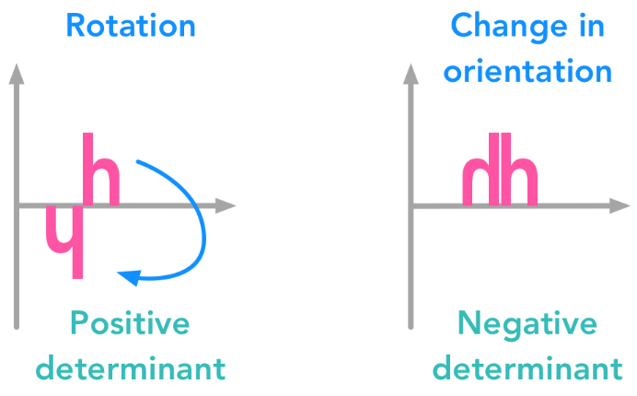
Determinant of a Matrix

Slide 20
The multiplicative inverse of a matrix
This can only be done with SQUARE matrices
Inverses of larger square matrices can be calculated but can be quite time expensive for large matrices, computers are generally used
Ex A = then A⁻¹ =
as AxA⁻¹ = I

Slide 21
Example Find Inverse of A
Step 1 – Calc Determinant
Determinant (ad-cb) = 4x3-8x1 = 4
Step 2 – Swap Elements on leading diagonal
Step 3 – negate the other elements
Step 4 – multiply by 1/determinant

Slide 22
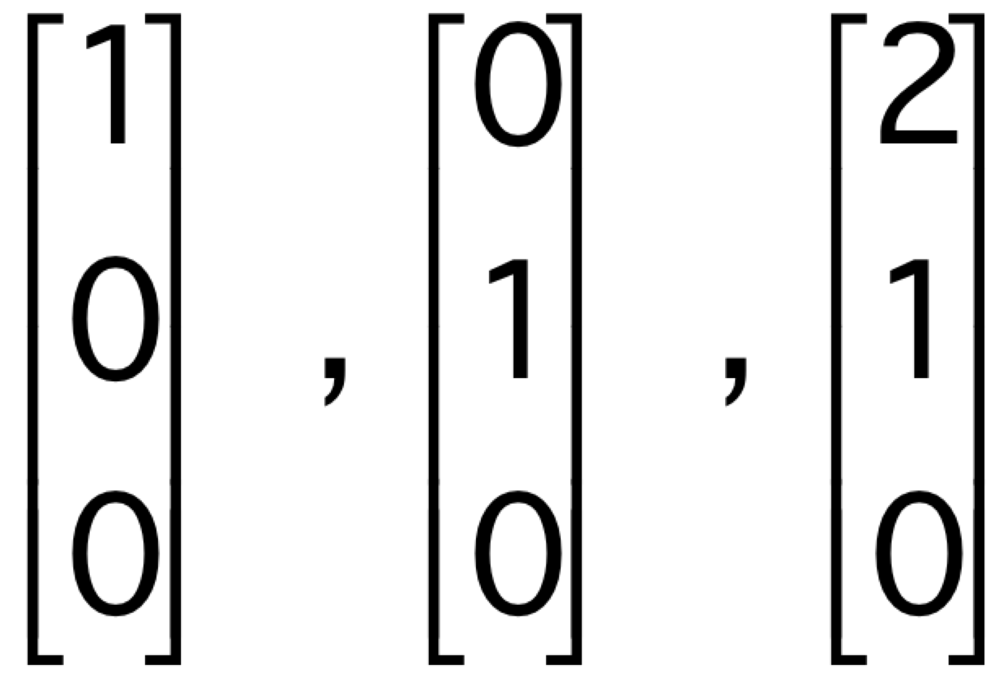
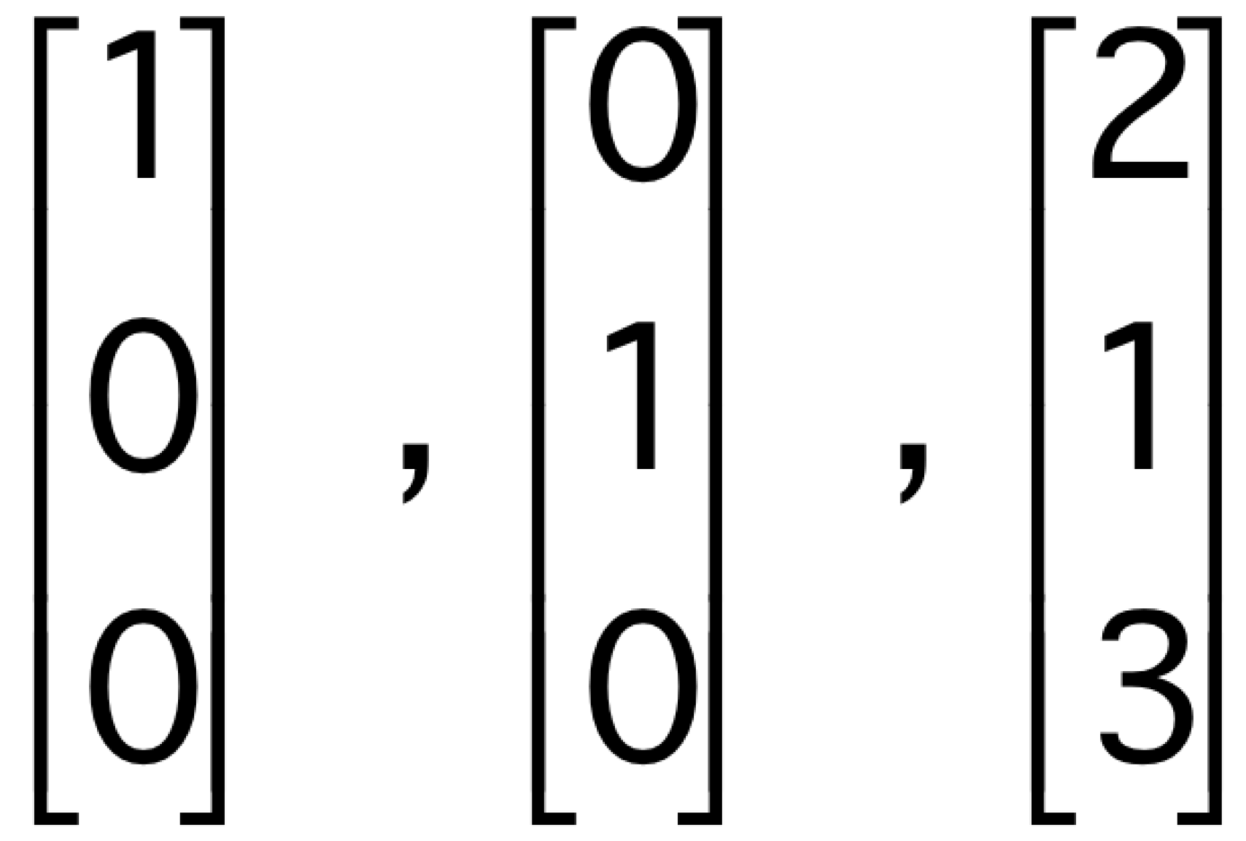
Linear Independence
A set of vectors is linearly dependent if one of the vectors can be expressed as a linear combination of the other vectors.
Example:
A set of vectors is linearly independent if none of the vectors can be expressed as a linear combination of the other vectors.
Example:

Slide 23
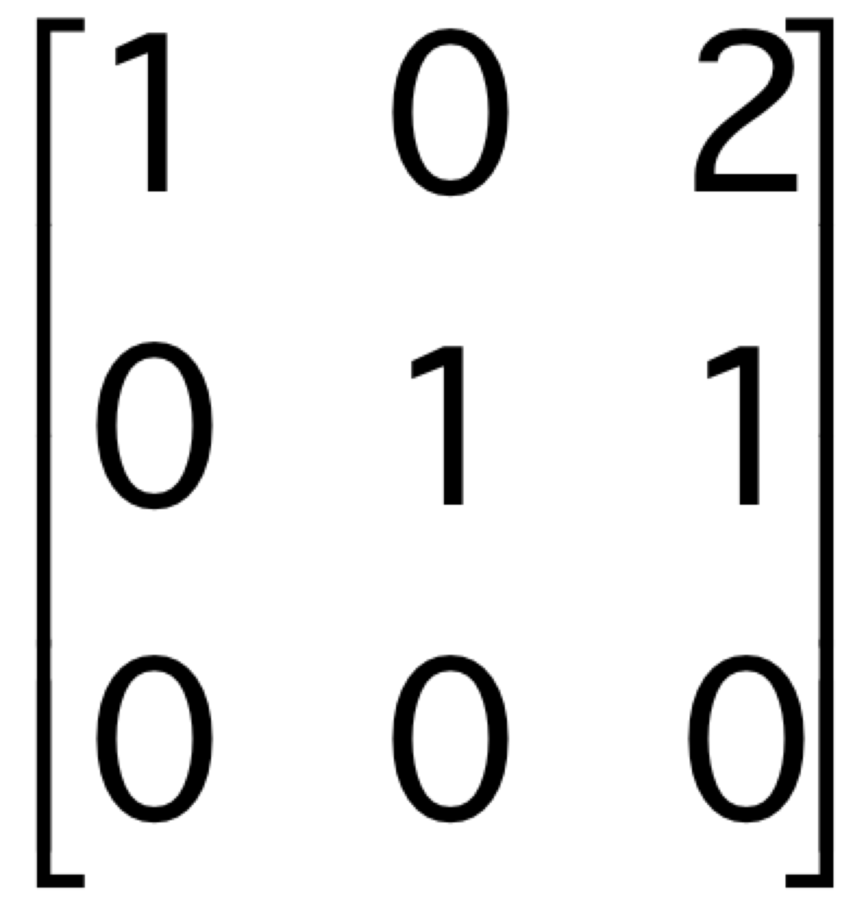
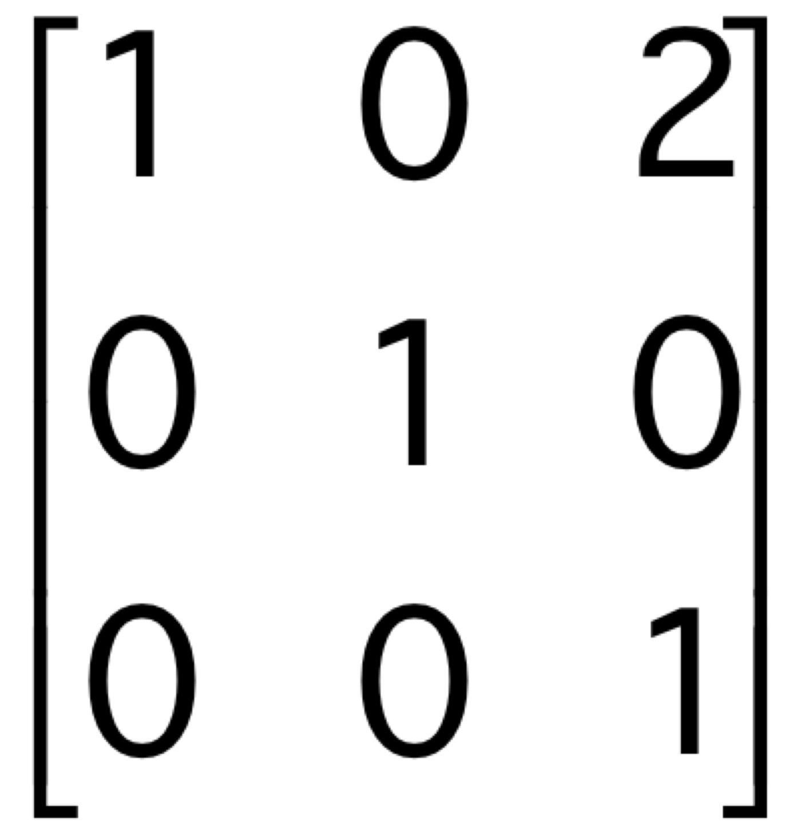
Rank of a matrix
The rank of a matrix is the number of linearly independent columns of the matrix.
Examples:
has rank 2
has rank 3
Note: the rank of a matrix is also the number of linearly independent rows of the matrix.

Slide 24
Singular Matrix
All of the following conditions are equivalent. We say a square (n × n) matrix is singular if any one of these conditions (and hence all of them) is satisfied.
The columns are linearly dependent
The rows are linearly dependent
The determinant = 0
The matrix is not invertible
The matrix is not full rank (i.e., rank < n)

Slide 25
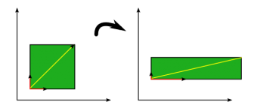
Eigenvalue and Eigen Vector

Slide 26
Eigenvalue and Eigen Vector
Let A be an n x n matrix. A scalar λ is called an eigenvalue of A if there is a nonzero vector X such that
AX = λX
Such a vector X is called an eigenvector of A corresponding to λ.
Google uses the eigenvector corresponding to the maximal eigenvalue of the Google matrix to determine the rank of a page for search.

Slide 27
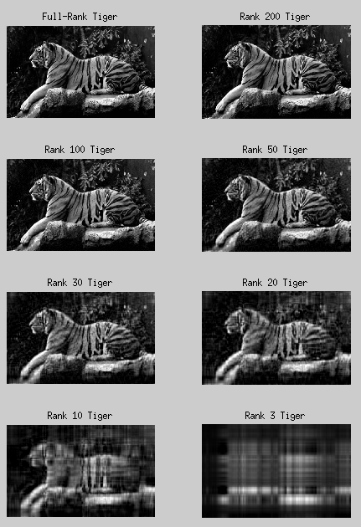

SVD
Notes:
https://hadrienj.github.io/posts/Deep-Learning-Book-Series-2.8-Singular-Value-Decomposition/
https://math.stackexchange.com/questions/1383725/what-is-the-difference-between-orthogonal-and-orthonormal-in-terms-of-vectors-an

Slide 28
SVD
Any real m x n matrix A can be decomposed uniquely:
U is m x n and column orthonormal (U^{T}U=I)
D is n x n and diagonal
σ_{i} are called singular values of A
It is assumed that σ1 ≥ σ₂ ≥ … ≥ σ_{n} ≥ 0
V is n x n and orthonormal (VV^{T}=V^{T}V=I)
Notes:
https://hadrienj.github.io/posts/Deep-Learning-Book-Series-2.8-Singular-Value-Decomposition/
https://math.stackexchange.com/questions/1383725/what-is-the-difference-between-orthogonal-and-orthonormal-in-terms-of-vectors-an

Slide 29
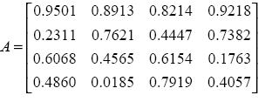
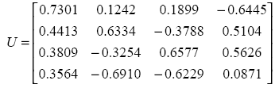
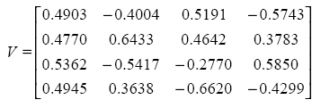
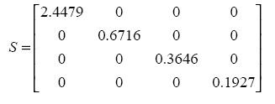
SVD
U = (u₁ u₂ . . . u_{n})
V = (v₁ v₂ . . . v_{n})
D

Slide 30
SVD
SVD is used in missing value problems when certain values are not known.
A sparse document-term matrix can get a dense representation using SVD
Data compression and reduction
. . .

Slide 31
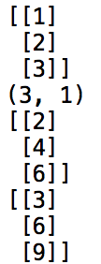
Vector
Vector operations:
import numpy as np
v=np.array([[1],[2],[3]]) #creating a vector
print(v) #printing a vector
print(v.shape) #order of a vector
print(v+v) #vector addition
print(3*v) #scalar multiplication

Slide 32
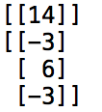
Vector
Vector operations:
import numpy as np
v1 = np.array([[1],[2],[3]])
v2 = np.array([[4],[5],[6]])
print (v1.T.dot(v1)) #dot product
print (np.cross(v1, v2, axisa=0, axisb=0).T) #cross product

Slide 33


Matrix
Creating a matrix:
import numpy as np
A= np.arange(21,30).reshape(3,3)
print (A)
Taking a transpose:
import numpy as np
A= np.arange(21,30).reshape(3,3)
A.transpose()

Slide 34

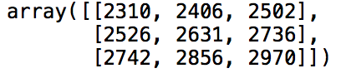
Matrix
Multiplication of two matrices A.B:
import numpy as np
A=np.arange(21,30).reshape(3,3) B=np.arange(31,40).reshape(3,3)
A.dot(B)
Multiplication of two matrices B.A:
import numpy as np
A=np.arange(21,30).reshape(3,3) B=np.arange(31,40).reshape(3,3)
B.dot(A)

Slide 35
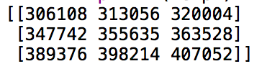
Matrix
Matrix Multiplication is Associative (A.B).C= A.(B.C)
import numpy as np A=np.arange(21,30).reshape(3,3)
B=np.arange(31,40).reshape(3,3)
C=np.arange(41,50).reshape(3,3)
temp1=(A.dot(B)).dot(C) # (A.B).C
print (temp1)
import numpy as np
A=np.arange(21,30).reshape(3,3)
B=np.arange(31,40).reshape(3,3)
C=np.arange(41,50).reshape(3,3)
temp2=A.dot((B.dot(C))) # A.(B.C)
print (temp2)

Slide 36
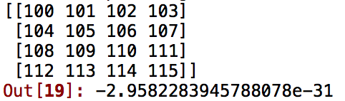
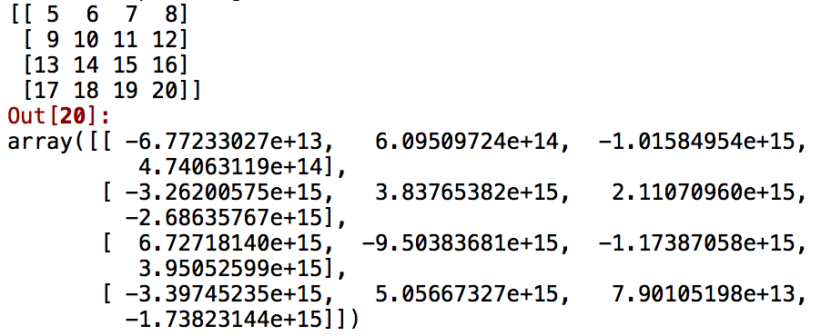
Matrix
Determinant of a Matrix:
import numpy as np
arr =np.arange(100,116).reshape(4,4)
print(arr)
np.linalg.det(arr)
Inverse of a matrix:
import numpy as np
arr1 = np.arange(5,21).reshape(4,4)
print(arr1)
np.linalg.inv(arr1)

Slide 37
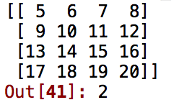
Matrix
Rank of a Matrix:
from numpy.linalg import matrix_rank
arr1 = np.arange(5,21).reshape(4,4)
print(arr1)
matrix_rank(arr1)

Slide 38
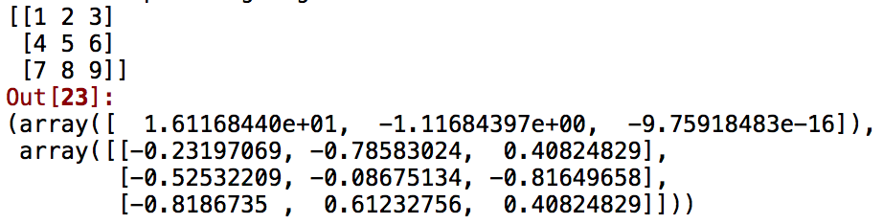
Matrix
Eigenvalues of a Matrix:
import numpy as np
arr2 = np.arange(1,10).reshape(3,3)
print(arr2)
np.linalg.eig(arr2)

Slide 39
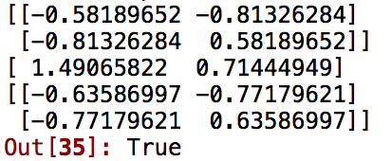
Matrix
SVD of a Matrix:
import numpy as np
A = np.matrix([[1, 0.3], [0.45, 1.2]])
U, s, V = np.linalg.svd(A)
print(U)
print(s)
print(V)
np.allclose(A, U * np.diag(s) * V)

